Slide 1
Lecture #12: Graphs
Graphs: Introduction Trails, Paths, and Circuits Matrix Representations Isomorphism and Planar Graphs
Aaron Tan
AY2022/23 Semester 1

Slide 2
Graphs: Introduction Trails, Paths, and Circuits Matrix Representations Isomorphism and Planar Graphs
10. Graphs and Trees
10.1 Graphs: Definitions and Basic Properties
Introduction, Basic Terminology
10.2 Trails, Paths, and Circuits
Definitions
The Concept of Degree
10.3 Matrix Representations of Graphs
Matrices and Directed Graphs; Matrices and Undirected Graphs
Matrix Multiplication
Special Graphs
Connectedness
Euler Circuits and Hamiltonian Circuits
10.4 Isomorphisms of Graphs/Planar Graphs
Definition of Graph Isomorphism
Counting Walks of Length N
Planar Graphs and Euler’s Formula
Reference: Epp’s Chapter 10 Graphs and Trees

Slide 3
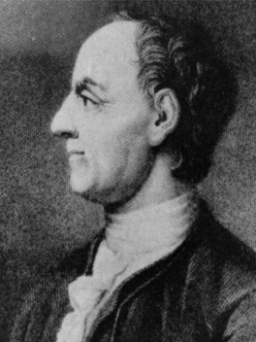
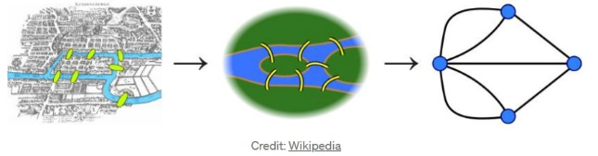
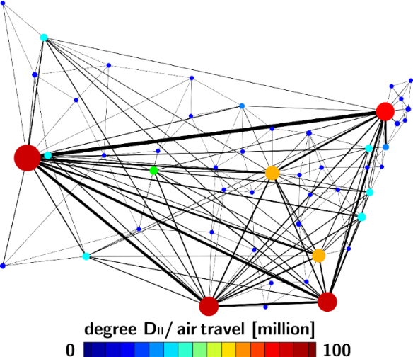
Graphs: Introduction Trails, Paths, and Circuits Matrix Representations Graph Isomorphism/Planar Graphs
Graphs: Introduction
“The origins of graph theory are humble, even frivolous.” ~Norman L. Biggs
The 7 bridges of Königsberg
The Father of Graph Theory
Leonhard Euler (1707-1783)
Euler’s formula: F + V = E + 2
Knight’s Tour Problem
Graph as an excellent modelling tool…
Travelling Salesman Problem
Applications:
CS: hardware, data structures, image processing, data mining, network design, etc.
GPS to find shortest path
Ranking hyperlinks in search engines
Social network analysis
DNA sequence
…
Network model of COVID-19 spreading across the United States

Slide 4
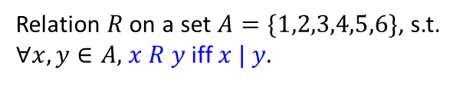
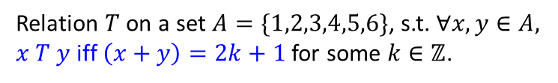
Graphs: Introduction Trails, Paths, and Circuits Matrix Representations Graph Isomorphism/Planar Graphs
Graphs: Introduction
Graphs are mathematical structures used to model pairwise relations between objects.
Types of graphs (informal intro):
a
e
a
e
a
e
a
12
e
21
10
d
d
d
37
d
8
b
f
b
f
b
f
b
55
f
c
c
c
10
c
Undirected graph
Directed graph (Digraph)
Directed acyclic graph (DAG)
Weighted graph
Bet you have seen graphs in CS1231/CS1231S before!
Relation $R$ on a set $A=\{1,2,3,4,5,6\}$, s.t. $∀x,y∈A,$ $x R y$ iff $x | y.$
Relation $T$ on a set $A=\{1,2,3,4,5,6\}$, s.t. $∀x,y∈A,$ $x T y$ iff $\left(x+y\right)=2k+1$ for some $k∈ℤ$.
4
6
4
6
3
3
2
5
2
5
1
1

Slide 5
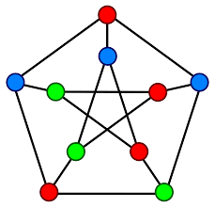
Graphs: Definitions Trails, Paths, and Circuits Matrix Representations Graph Isomorphism/Planar Graphs
10.1 Graphs: Definitions and Basic Properties

Slide 6
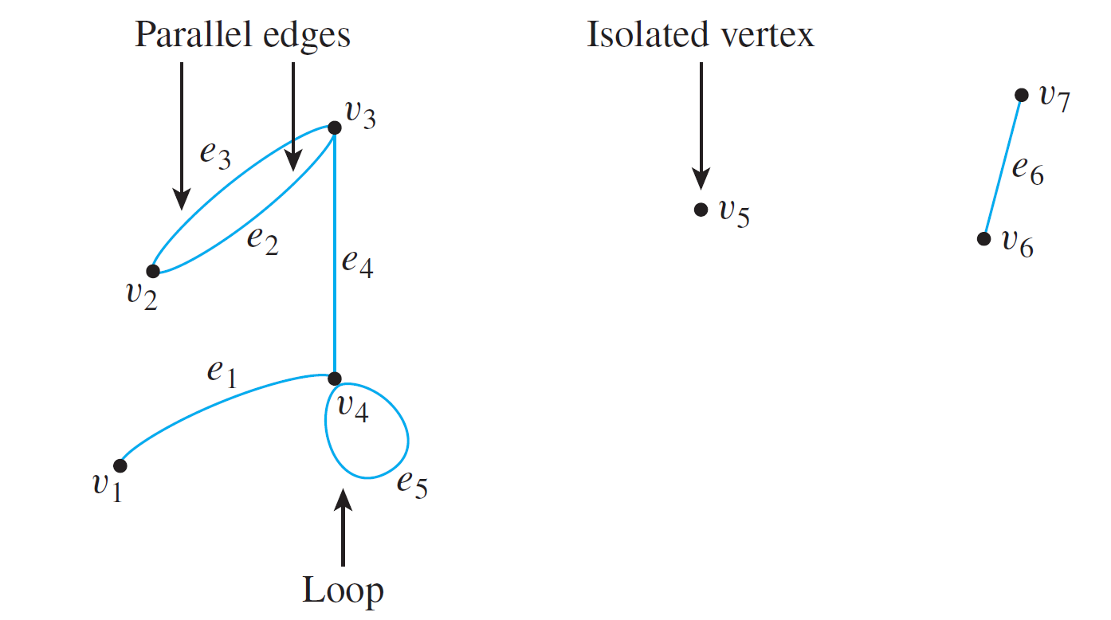
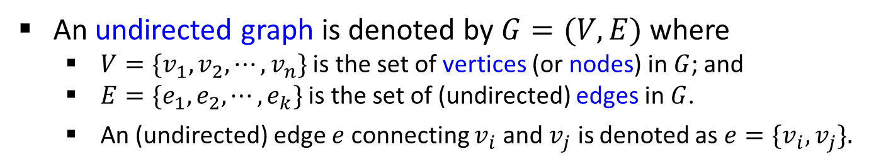
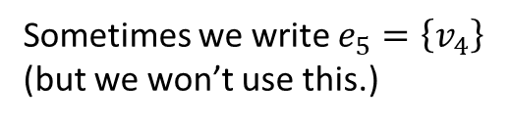
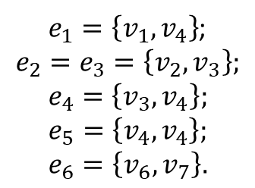
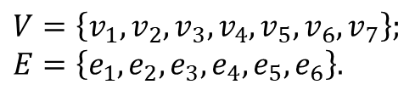
Graphs: Definitions Trails, Paths, and Circuits Matrix Representations Graph Isomorphism/Planar Graphs
Graphs: Definitions and Basic Properties
Graphs: Definitions and Basic Properties
An undirected graph is denoted by $G=(V,E)$ where
$V=\{v_{1},v_{2},⋯,v_{n}\}$ is the set of vertices (or nodes) in $G$; and
$E=\{e_{1},e_{2},⋯,e_{k}\}$ is the set of (undirected) edges in $G$.
An (undirected) edge $e$ connecting $v_{i}$ and $v_{j}$ is denoted as ${e=\{v}_{i},v_{j}\}.$
$e_{1}=\left\{v_{1},v_{4}\right\}$;
$$e_{2}=e_{3}=\left\{v_{2},v_{3}\right\};$$
$$e_{4}=\left\{v_{3},v_{4}\right\};$$
$$e_{5}=\left\{v_{4},v_{4}\right\};$$
$$e_{6}=\left\{v_{6},v_{7}\right\}.$$
Example:
$$V=\left\{v_{1},v_{2},v_{3},v_{4},v_{5},v_{6},v_{7}\right\};$$
$$E=\left\{e_{1},e_{2},e_{3},e_{4},e_{5},e_{6}\right\}.$$
Sometimes we write $e_{5}=\left\{v_{4}\right\}$
(but we won’t use this.)

Slide 7
Graphs: Definitions Trails, Paths, and Circuits Matrix Representations Graph Isomorphism/Planar Graphs
Graphs: Definitions and Basic Properties
Graphs: Definitions and Basic Properties
Definition: Undirected Graph
An undirected graph G consists of 2 finite sets: a nonempty set V of vertices and a set E of edges, where each (undirected) edge is associated with a set consisting of either one or two vertices called its endpoints.
An edge is said to connect its endpoints; two vertices that are connected by an edge are called adjacent vertices; and a vertex that is an endpoint of a loop is said to be adjacent to itself.
An edge is said to be incident on each of its endpoints, and two edges incident on the same endpoint are called adjacent edges.
We write e = {v, w} for an undirected edge e incident on vertices v and w.

Slide 8
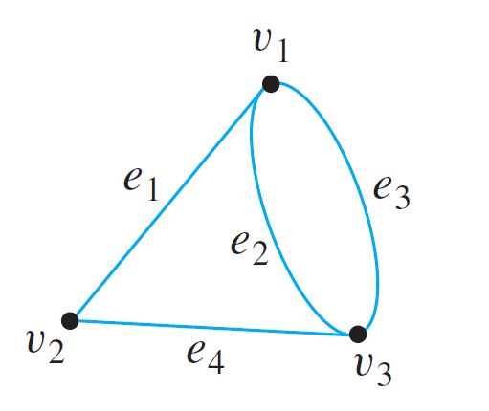
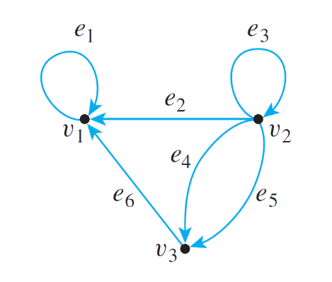
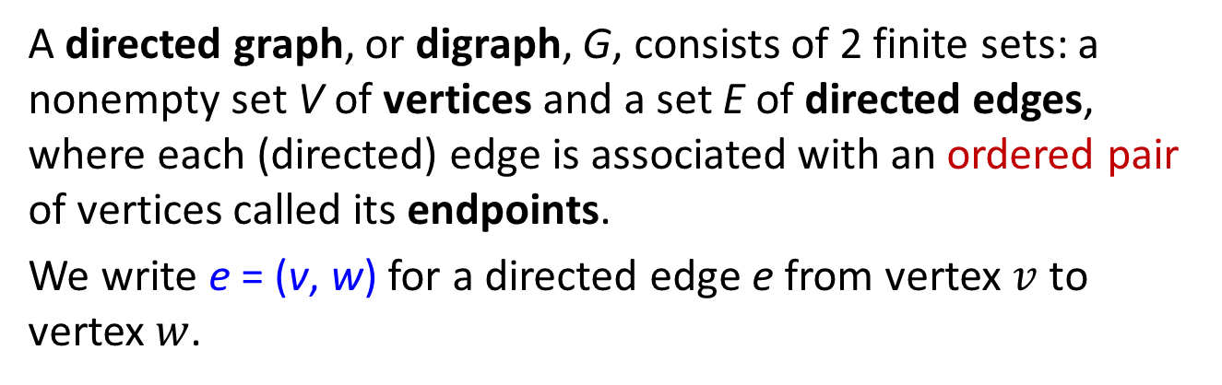


Graphs: Definitions Trails, Paths, and Circuits Matrix Representations Graph Isomorphism/Planar Graphs
Graphs: Definitions and Basic Properties
Graphs: Definitions and Basic Properties
Definition: Directed Graph
A directed graph, or digraph, G, consists of 2 finite sets: a nonempty set V of vertices and a set E of directed edges, where each (directed) edge is associated with an ordered pair of vertices called its endpoints.
We write e = (v, w) for a directed edge e from vertex $v$ to vertex $w$.
Undirected graph
Directed graph
$$e_{2}=\{v_{1},v_{3}\}$$
$$e_{2}=(v_{2},v_{1})$$

Slide 9
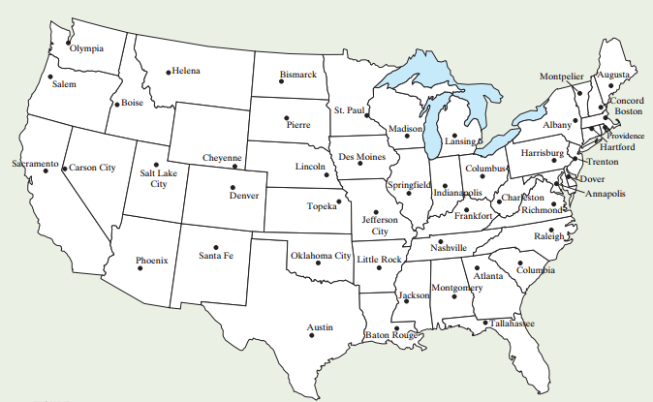
Graphs: Definitions Trails, Paths, and Circuits Matrix Representations Graph Isomorphism/Planar Graphs
Graphs: Introduction
Map Colouring
Shall we add some colours to this map of the United States?

Slide 10
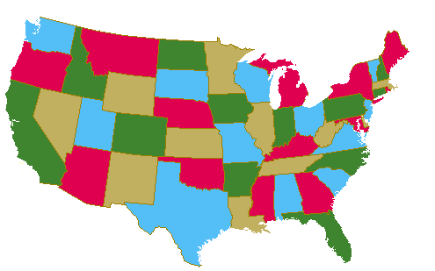
Graphs: Definitions Trails, Paths, and Circuits Matrix Representations Graph Isomorphism/Planar Graphs
Graphs: Introduction
Map Colouring
Shall we add some colours to this map of the United States?

Slide 11
Graphs: Definitions Trails, Paths, and Circuits Matrix Representations Graph Isomorphism/Planar Graphs
Graphs: Introduction
Map Colouring
Four-Colour Conjecture
Proposed by Guthrie in 1852, who conjectured that…
Four colours are sufficient to colour any map in a plane, such that regions that share a common boundary do not share the same colour.
Many false proofs since then.
Finally proved by Appel and Haken in 1977, with the help of computer.
Robertson et al. provided another proof in 1996.

Slide 12
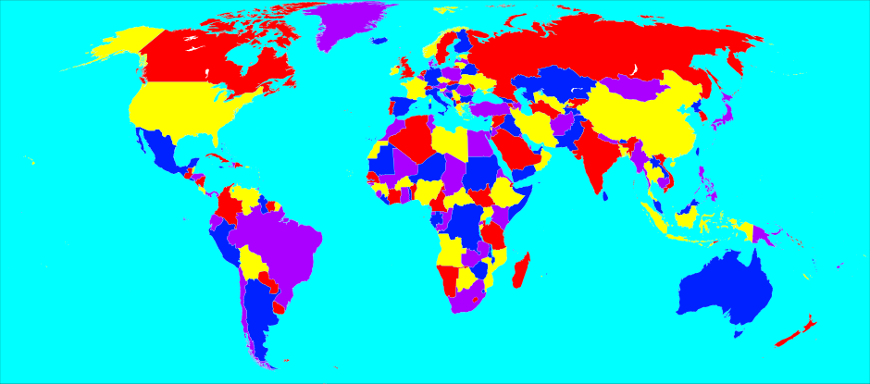

Graphs: Definitions Trails, Paths, and Circuits Matrix Representations Graph Isomorphism/Planar Graphs
Graphs: Introduction
Map Colouring
Example of a 4-coloured map.
World map with 4 colours.
But this is a map, not a graph!
However, we can model it as a graph.
But what is a graph?

Slide 13
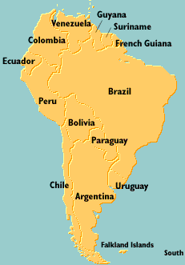
Graphs: Definitions Trails, Paths, and Circuits Matrix Representations Graph Isomorphism/Planar Graphs
Modelling Graph Problems
Modelling Graph Problems
Map Colouring Problem
Solve it as a graph problem.
Draw a graph in which the vertices represent the states, with every edge joining two vertices represents the states sharing a common border.
Such two vertices cannot be coloured with the same colour.
A vertex colouring of a graph is an assignment of colours to vertices so that no two adjacent vertices have the same colour.

Slide 14
Graphs: Definitions Trails, Paths, and Circuits Matrix Representations Graph Isomorphism/Planar Graphs
Modelling Graph Problems
Modelling Graph Problems
Guy
Ven
Sur
Col
Fre
Bra
Ecu
Per
Bol
Par
Chi
Uru
Arg
Fal

Slide 15
Graphs: Definitions Trails, Paths, and Circuits Matrix Representations Graph Isomorphism/Planar Graphs
Modelling Graph Problems
Try colouring the vertices so that no two adjacent vertices have the same colour, using the least number of colours.
Modelling Graph Problems
Guy
Ven
Sur
Col
Fre
Bra
Ecu
Per
Bol
Par
Chi
Uru
Arg
Fal


Slide 16

Graphs: Definitions Trails, Paths, and Circuits Matrix Representations Graph Isomorphism/Planar Graphs
Modelling Graph Problems
Wedding Planner
You are your best friend’s wedding planner and you need to plan the seating arrangement for his 16 guests attending his wedding dinner. However, some of the guests cannot get along with some others.
A doesn’t get along with F, G or H.
B doesn’t get along with C, D or H.
C doesn’t get along with B, D, E, G or H.
D doesn’t get along with B, C or E.
E doesn’t get along with C, D, F, or G.
F doesn’t get along with A, E or G.
G doesn’t get along with A, C, E or F.
H doesn’t get along with A, B or C.
You don’t want to put guests who cannot get along with each other at the same table!
How many tables do you need?
Acknowledgement: http://www.math.uri.edu/~eaton/0131873814_MEb.pdf

Slide 17
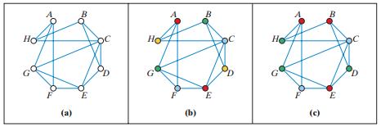
Graphs: Definitions Trails, Paths, and Circuits Matrix Representations Graph Isomorphism/Planar Graphs
Modelling Graph Problems
A doesn’t get along with F, G or H.
B doesn’t get along with C, D or H.
C doesn’t get along with B, D, E, G or H.
D doesn’t get along with B, C or E.
E doesn’t get along with C, D, F, or G.
F doesn’t get along with A, E or G.
G doesn’t get along with A, C, E or F.
H doesn’t get along with A, B or C.
Wedding Planner
Graph with vertices representing the guests, and an edge is drawn between two guests who don’t get along.
Vertex colouring problem. 4 colours (4 tables)?

Acknowledgement: http://www.math.uri.edu/~eaton/0131873814_MEb.pdf

Slide 18
Graphs: Definitions Trails, Paths, and Circuits Matrix Representations Graph Isomorphism/Planar Graphs
Modelling Graph Problems
Other Vertex Colouring Problems
 | If the vertices represent… | And two vertices are adjacent if …. | Then a vertex colouring can be used to…
1. | classes, | the corresponding classes have students in common, | schedule classes.
2. | radio stations, | the stations are close enough to interfere with each other, | assign non-interfering frequencies to the stations.
3. | traffic signals at an intersection, | the corresponding signals cannot be green at the same time, | designate sets of signals that can be green at the same time.

Slide 19
Graphs: Definitions Trails, Paths, and Circuits Matrix Representations Graph Isomorphism/Planar Graphs
Special Graphs
Simple Graphs
Definition: Simple Graph
A simple graph is an undirected graph that does not have any loops or parallel edges. (That is, there is at most one edge between each pair of distinct vertices.)
Simple graph
Non simple graph
Non simple graph

Slide 20
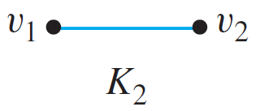

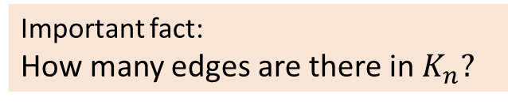

Graphs: Definitions Trails, Paths, and Circuits Matrix Representations Graph Isomorphism/Planar Graphs
Special Graphs
Complete Graphs
Definition: Complete Graph
A complete graph on n vertices, n > 0, denoted K_{n}, is a simple graph with n vertices and exactly one edge connecting each pair of distinct vertices .
Draw $K5$.
Fun: The notation $K_{n}$ is rumoured to be used to honour the contributions of Kazimierz Kuratowski to graph theory.
Important fact:
How many edges are there in $K_{n}?$


Slide 21
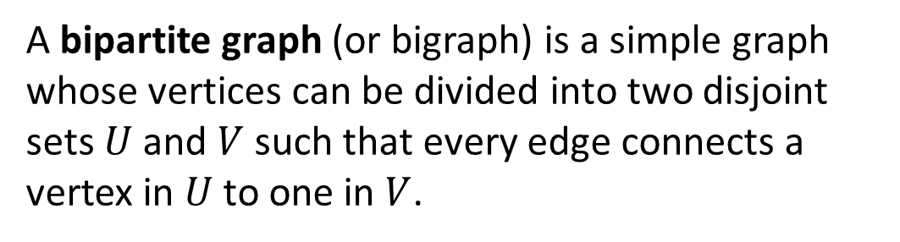
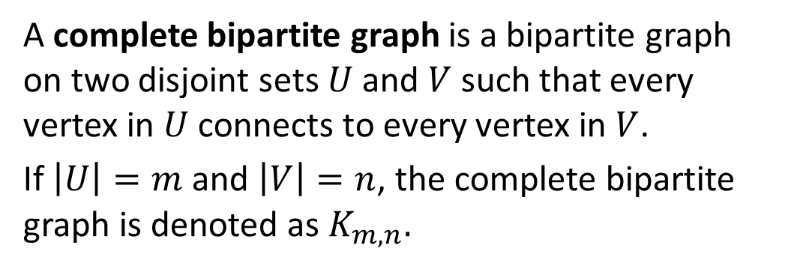


Graphs: Definitions Trails, Paths, and Circuits Matrix Representations Graph Isomorphism/Planar Graphs
Special Graphs
Bipartite Graphs and Complete Bipartite Graphs
Definition: Bipartite Graph
A bipartite graph (or bigraph) is a simple graph whose vertices can be divided into two disjoint sets $U$ and $V$ such that every edge connects a vertex in $U$ to one in $V$.
Bipartite graph
Definition: Complete Bipartite Graph
$$K_{3,2}$$
A complete bipartite graph is a bipartite graph on two disjoint sets $U$ and $V$ such that every vertex in $U$ connects to every vertex in $V$.
If $\left|U\right|=m$ and $\left|V\right|=n$, the complete bipartite graph is denoted as $K_{m,n}.$
$$K_{2,5}$$

Slide 22
Graphs: Definitions Trails, Paths, and Circuits Matrix Representations Graph Isomorphism/Planar Graphs
Special Graphs
Subgraph of a Graph
Definition: Subgraph of a Graph
A graph H is said to be a subgraph of graph G if and only if every vertex in H is also a vertex in G, every edge in H is also an edge in G, and every edge in H has the same endpoints as it has in G.
A graph G
Subgraphs of G

Slide 23
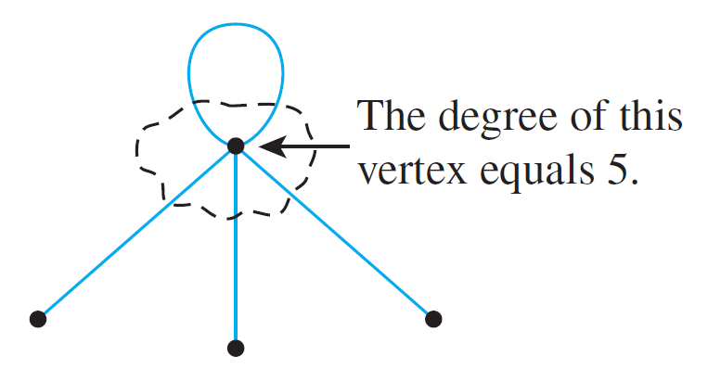
Graphs: Definitions Trails, Paths, and Circuits Matrix Representations Graph Isomorphism/Planar Graphs
The Concept of Degree
Degree of a Vertex and Total Degree of an Undirected Graph
Definition: Degree of a Vertex and Total Degree of an Undirected Graph
Let G be a undirected graph and v a vertex of G. The degree of v, denoted deg(v), equals the number of edges that are incident on v, with an edge that is a loop counted twice.
The total degree of G is the sum of the degrees of all the vertices of G.
The degree of a vertex can be obtained from the drawing of a graph by counting how many end segments of edges are incident on the vertex.

Slide 24
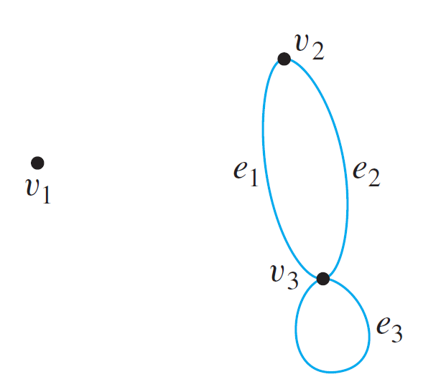
Graphs: Definitions Trails, Paths, and Circuits Matrix Representations Graph Isomorphism/Planar Graphs
The Concept of Degree
Degree of a Vertex and Total Degree of a Graph
Example: Find the degree of each vertex of the graph G shown below. Then find the total degree of G.
deg(v₁) = 0
deg(v₂) = 2
deg(v₃) = 4
Total degree of G = 6

Slide 25

Graphs: Definitions Trails, Paths, and Circuits Matrix Representations Graph Isomorphism/Planar Graphs
The Concept of Degree
Theorem 10.1.1 The Handshake Theorem
If G is any graph, then the sum of the degrees of all the vertices of G equals twice the number of edges of G. Specifically, if the vertices of G are v₁, v₂, …, v_{n}, where n ≥ 0, then
The total degree of G = deg(v₁) + deg(v₂) + … + deg(v_{n})
= 2 × (the number of edges of G).
Corollary 10.1.2
The total degree of a graph is even.
Proposition 10.1.3
In any graph there are an even number of vertices of odd degree.

Slide 26
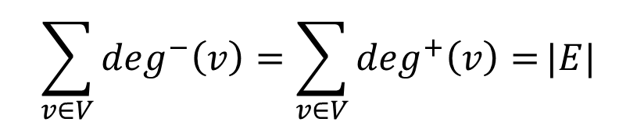
Graphs: Definitions Trails, Paths, and Circuits Matrix Representations Graph Isomorphism/Planar Graphs
The Concept of Degree
Indegree and Outdegree of a Vertex of a Directed Graph
Definition: Indegree and outdegree of a Vertex of a Directed Graph
Let G=(V,E) be a directed graph and v a vertex of G. The indegree of v, denoted deg⁻(v), is the number of directed edges that end at v. The outdegree of v, denoted deg⁺(v), is the number of directed edges that originate from v.
Note that
$$\sum_{v∈V}{\deg^{−}\left(v\right)=\sum_{v∈V}{\deg^{+}\left(v\right)=}}|E|$$
a
deg ⁻ (a) = 2; deg ⁺(a) = 0;
deg ⁻ (b) = 0; deg ⁺(b) = 2;
deg ⁻ (c) = 2; deg ⁺(c) = 2;
deg ⁻ (d) = 1; deg ⁺(d) = 1.
c
d
b

Slide 27
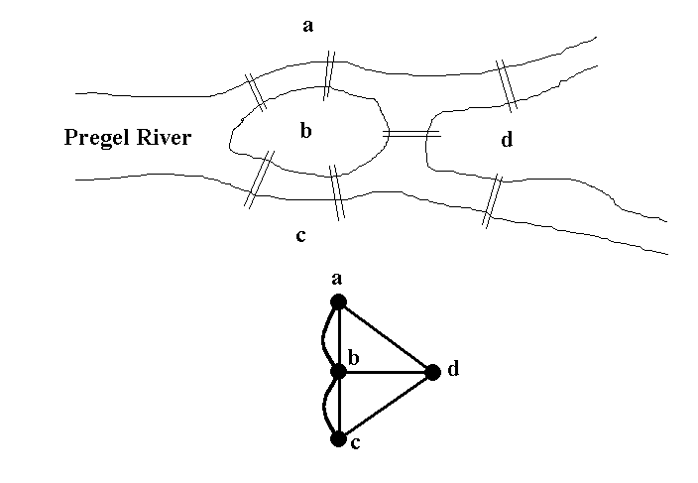
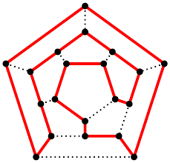
Graphs: Definitions Trails, Paths, and Circuits Matrix Representations Graph Isomorphism/Planar Graphs
10.2 Trails, Paths, and Circuits

Slide 28
Graphs: Definitions Trails, Paths, and Circuits Matrix Representations Graph Isomorphism/Planar Graphs
Introduction
Let’s Have Some Fun
Can you draw the following figures without lifting up your pencil?
(1)
(2)
(3)
(4)
(5)
(6)
(7)
(8)

Slide 29
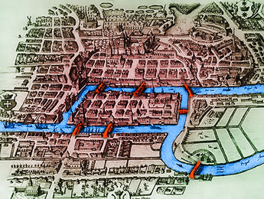
Graphs: Definitions Trails, Paths, and Circuits Matrix Representations Graph Isomorphism/Planar Graphs
Introduction
Königsberg bridges
The subject of graph theory began in the year 1736 when the great mathematician Leonhard Euler published a paper giving the solution to the following puzzle:
The town of Königsberg in Prussia (now Kaliningrad in Russia) was built at a point where two branches of the Pregel River came together. It consisted of an island and some land along the river banks.
These were connected by 7 bridges.
Euler asked: Is it possible to take a walk around town, starting and ending at the same location and crossing each of the 7 bridges exactly once?

Slide 30
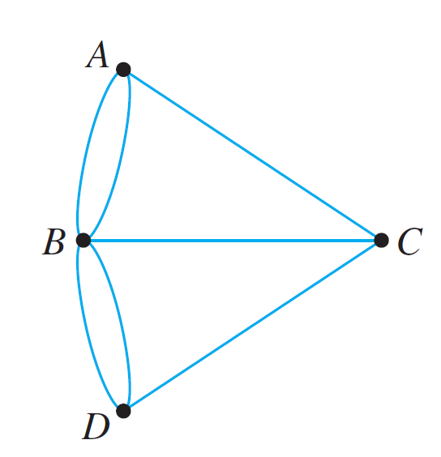
Graphs: Definitions Trails, Paths, and Circuits Matrix Representations Graph Isomorphism/Planar Graphs
Introduction
Königsberg bridges
In terms of this graph, the question is:
Is it possible to find a route through the graph that starts and ends at some vertex (A, B, C, or D) and traverses each edge exactly once?
Euler asked: Is it possible to take a walk around town, starting and ending at the same location and crossing each of the 7 bridges exactly once?

Slide 31
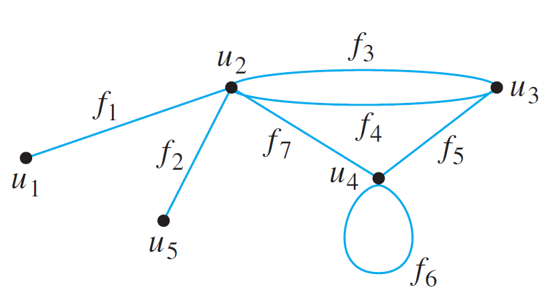
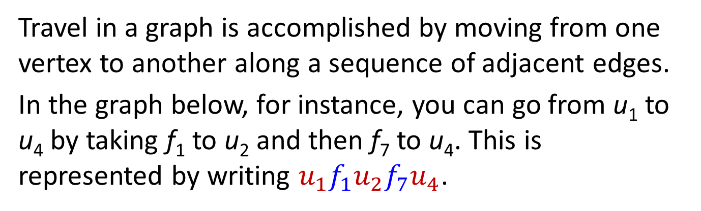

Graphs: Definitions Trails, Paths, and Circuits Matrix Representations Graph Isomorphism/Planar Graphs
Definitions
Definitions
Travel in a graph is accomplished by moving from one vertex to another along a sequence of adjacent edges.
In the graph below, for instance, you can go from u₁ to u₄ by taking f₁ to u₂ and then f₇ to u₄. This is represented by writing $u_{1}f_{1}u_{2}f_{7}u_{4}$.
Or, you could take a longer route:
$$u_{1}f_{1}u_{2}f_{3}u_{3}f_{4}u_{2}f_{3}u_{3}f_{5}u_{4}$$

Slide 32
Graphs: Definitions Trails, Paths, and Circuits Matrix Representations Graph Isomorphism/Planar Graphs
Definitions
Walk, Trail, Path, Closed Walk, Circuit, Simple Circuit
Definitions
Let G be a graph, and let v and w be vertices of G.
A walk from v to w is a finite alternating sequence of adjacent vertices and edges of G. Thus a walk has the form
v₀ e₁ v₁ e₂ … v_{n-1} e_{n} v_{n} ,
where the v’s represent vertices, the e’s represent edges, v₀=v, v_{n}=w, and for all i ∈ {1, 2, …, n}, v_{i-1} and v_{i} are the endpoints of e_{i}. The number of edges, n, is the length of the walk.
The trivial walk from v to v consists of the single vertex v.
A trail from v to w is a walk from v to w that does not contain a repeated edge.
A path from v to w is a trail that does not contain a repeated vertex.

Slide 33














Graphs: Definitions Trails, Paths, and Circuits Matrix Representations Graph Isomorphism/Planar Graphs
Definitions
Walk, Trail, Path, Closed Walk, Circuit, Simple Circuit
Definitions
A closed walk is a walk that starts and ends at the same vertex.
A circuit (or cycle) is a closed walk of length at least 3 that does not contain a repeated edge.
A simple circuit (or simple cycle) is a circuit that does not have any other repeated vertex except the first and last.
An undirected graph is cyclic if it contains a loop or a cycle; otherwise, it is acyclic.
$$u_{1}$$
$$u_{2}$$
$$u_{3}$$
Examples:
$$e_{1}$$
$u_{1}e_{1}u_{2}e_{3}u_{5}e_{4}u_{3}e_{5}u_{6}e_{7}u_{5}{e_{3}u}_{2}$ is a walk (may repeat edges and/or vertices).
$$e_{2}$$
$$e_{3}$$
$$e_{4}$$
$$e_{5}$$
$u_{1}e_{1}u_{2}e_{3}u_{5}e_{4}u_{3}e_{5}u_{6}e_{7}u_{5}{e_{6}u}_{4}$ is a trail (must not repeat edges).
$u_{1}e_{1}u_{2}e_{3}u_{5}e_{4}u_{3}e_{5}u_{6}$ is a path (must not repeat vertices and edges).
$$u_{4}$$
$$e_{6}$$
$$u_{5}$$
$$e_{7}$$
$$u_{6}$$
$u_{5}e_{6}u_{4}e_{2}u_{1}e_{1}u_{2}e_{3}u_{5}e_{7}u_{6}e_{5}u_{3}e_{4}u_{5}$ is a circuit.
$u_{5}e_{6}u_{4}e_{2}u_{1}e_{1}u_{2}e_{3}u_{5}$ is a simple circuit.

Slide 34
Graphs: Definitions Trails, Paths, and Circuits Matrix Representations Graph Isomorphism/Planar Graphs
Definitions
Notes
Because most of the major developments in graph theory have happened relatively recently and in a variety of different contexts, the terms used in the subject have not been standardized.
Susanna Epp’s book | Others
Graph | Multigraph
Simple graph | Graph
Vertex | Node
Edge | Arc
Trail | Path
Path | Simple path
Simple circuit | Cycle
The terminology in this book is among the most common, but if you consult other sources, be sure to check their definitions.
For CS1231S, we will follow the terminology in Epp’s book.

Slide 35
Graphs: Definitions Trails, Paths, and Circuits Matrix Representations Graph Isomorphism/Planar Graphs
Connectedness
Connectedness
A graph is connected if it is possible to travel from any vertex to any other vertex along a sequence of adjacent edges of the graph.
Definition: Connectedness
Two vertices v and w of a graph G=(V,E) are connected if and only if there is a walk from v to w.
The graph G is connected if and only if given any two vertices v and w in G, there is a walk from v to w. Symbolically,
G is connected iff ∀ vertices v, w ∈V, ∃ a walk from v to w.

Slide 36
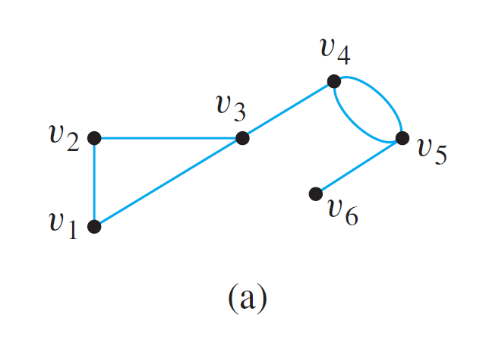
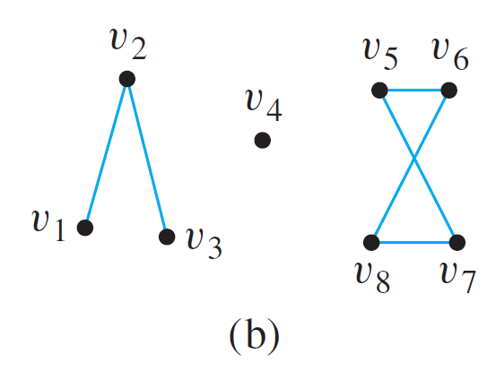
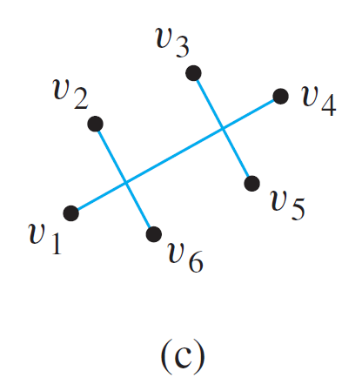
Graphs: Definitions Trails, Paths, and Circuits Matrix Representations Graph Isomorphism/Planar Graphs
Connectedness
Example: Which of the following graphs are connected?


Slide 37
Graphs: Definitions Trails, Paths, and Circuits Matrix Representations Graph Isomorphism/Planar Graphs
Connectedness
Some useful facts relating circuits and connectedness are collected in the following lemma.
Lemma 10.2.1
Let G be a graph.
If G is connected, then any two distinct vertices of G can be connected by a path.
If vertices v and w are part of a circuit in G and one edge is removed from the circuit, then there still exists a trail from v to w in G.
If G is connected and G contains a circuit, then an edge of the circuit can be removed without disconnecting G.

Slide 38
Graphs: Definitions Trails, Paths, and Circuits Matrix Representations Graph Isomorphism/Planar Graphs
Connected Component
Connected Component
The graphs in (b) and (c) are both made up of three pieces, each of which is itself a connected graph.
A connected component of a graph is a connected subgraph of largest possible size.
Definition: Connected Component
A graph H is a connected component of a graph G if and only if
The graph H is a subgraph of G;
The graph H is connected; and
No connected subgraph of G has H as a subgraph and contains vertices or edges that are not in H.

Slide 39
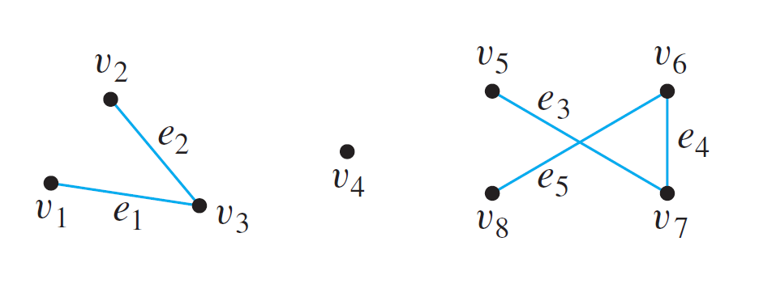
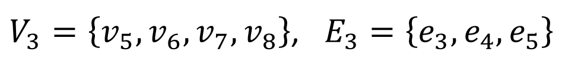
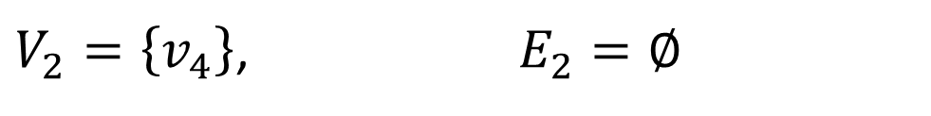
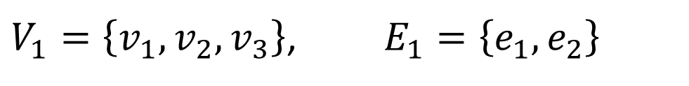
Graphs: Definitions Trails, Paths, and Circuits Matrix Representations Graph Isomorphism/Planar Graphs
Connected Component
Find all connected components of the following graph G.
G has 3 connected components H₁, H₂ and H₃ with vertex sets V₁, V₂ and V₃ and edge sets E₁, E₂ and E₃ , where
$V_{1}=\left\{v_{1},v_{2},v_{3}\right\}$, $E_{1}=\left\{e_{1},e_{2}\right\}$
$V_{2}=\left\{v_{4}\right\}$, $E_{2}=∅$
$V_{3}=\left\{v_{5},v_{6},v_{7},v_{8}\right\}$, $E_{3}=\left\{e_{3},e_{4},e_{5}\right\}$

Slide 40
Graphs: Definitions Trails, Paths, and Circuits Matrix Representations Graph Isomorphism/Planar Graphs
Euler Circuits
Euler Circuits
Now, let’s go back to the puzzle of the Königsberg bridges.
Is it possible to find a route through the graph that starts and ends at some vertex, one of A, B, C, or D, and traverses each edge exactly once?

Slide 41
Graphs: Definitions Trails, Paths, and Circuits Matrix Representations Graph Isomorphism/Planar Graphs
Euler Circuits
Definition: Euler Circuit
Let G be a graph. An Euler circuit for G is a circuit that contains every vertex and traverses every edge of G exactly once.
Definition: Eulerian Graph
An Eulerian graph is a graph that contains an Euler circuit.
Theorem 10.2.2
If a graph has an Euler circuit, then every vertex of the graph has positive even degree.
Contrapositive Version of Theorem 10.2.2
If some vertex of a graph has odd degree, then the graph does not have an Euler circuit.

Slide 42
Graphs: Definitions Trails, Paths, and Circuits Matrix Representations Graph Isomorphism/Planar Graphs
Euler Circuits
Is this true?
If every vertex of a graph has positive even degree, then the graph has an Euler circuit.
Theorem 10.2.3
If a graph G is connected and the degree of every vertex of G is a positive even integer, then G has an Euler circuit.
Theorem 10.2.4
A graph G has an Euler circuit if and only if G is connected and every vertex of G has positive even degree.


Slide 43
Graphs: Definitions Trails, Paths, and Circuits Matrix Representations Graph Isomorphism/Planar Graphs
Euler Circuits
Definition: Euler Trail
Let G be a graph, and let v and w be two distinct vertices of G. An Euler trail/path from v to w is a sequence of adjacent edges and vertices that starts at v, ends at w, passes through every vertex of G at least once, and traverses every edge of G exactly once.
Corollary 10.2.5
Let G be a graph, and let v and w be two distinct vertices of G. There is an Euler trail from v to w if and only if G is connected, v and w have odd degree, and all other vertices of G have positive even degree.

Slide 44
Graphs: Definitions Trails, Paths, and Circuits Matrix Representations Graph Isomorphism/Planar Graphs
Euler Circuits
Does each of the following graphs have an Euler circuit?
(1)
(2)
(3)
(4)
(5)
(6)
(7)
(8)


Slide 45




Graphs: Definitions Trails, Paths, and Circuits Matrix Representations Graph Isomorphism/Planar Graphs
Euler Circuits
The following graphs do not have an Euler circuit. Do they have an Euler trail?
$$v$$
$$w$$
$$v$$
$$w$$
(1)
(5)


Slide 46
Graphs: Definitions Trails, Paths, and Circuits Matrix Representations Graph Isomorphism/Planar Graphs
Hamiltonian Circuits
Hamiltonian Circuits
Recall Theorem 10.2.4:
Theorem 10.2.4
A graph G has an Euler circuit if and only if G is connected and every vertex of G has positive even degree.
A related question:
Given a graph G, is it possible to find a circuit for G in which all the vertices of G (except the first and the last) appear exactly once?

Slide 47
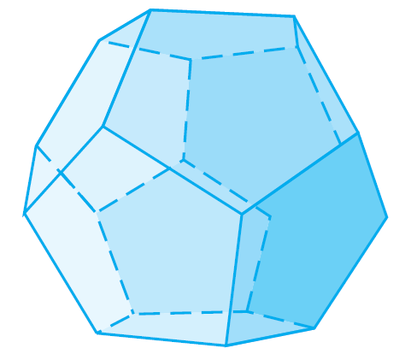
Graphs: Definitions Trails, Paths, and Circuits Matrix Representations Graph Isomorphism/Planar Graphs
Hamiltonian Circuits
In 1859 the Irish mathematician Sir William Rowan Hamilton introduced a puzzle in the shape of a dodecahedron (DOH-dek-a-HEE-dron). (Figure 10.2.6 contains a drawing of a dodecahedron, which is a solid figure with 12 identical pentagonal faces.)
Figure 10.2.6 Dodecahedron
Each vertex was labeled with the name of a city — London, Paris, Singapore, New York, and so on.
The problem Hamilton posed was to start at one city and tour the world by visiting each other city exactly once and returning to the starting city.

Slide 48
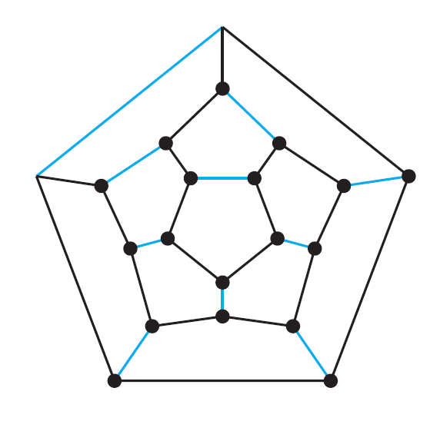
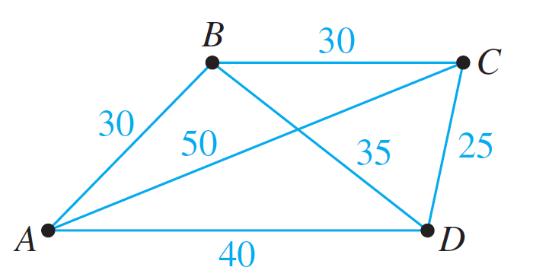
Graphs: Definitions Trails, Paths, and Circuits Matrix Representations Graph Isomorphism/Planar Graphs
Hamiltonian Circuits
One way to solve the puzzle is to imagine the surface of the dodecahedron stretched out and laid flat in the plane, as follows:
The circuit denoted with black lines is one solution. (Note that although every city is visited, many edges are omitted from the circuit.)
If we add values (called weights) to each edge, this becomes the travelling salesman problem.

Slide 49
Graphs: Definitions Trails, Paths, and Circuits Matrix Representations Graph Isomorphism/Planar Graphs
Hamiltonian Circuits
Definition: Hamiltonian Circuit
Given a graph G, a Hamiltonian circuit for G is a simple circuit that includes every vertex of G. (That is, every vertex appears exactly once, except for the first and the last, which are the same.)
Definition: Hamiltonian Graph
A Hamiltonian graph (also called Hamilton graph) is a graph that contains a Hamiltonian circuit.
Note that although an Euler circuit for a graph G must include every vertex of G, it may visit some vertices more than once and hence may not be a Hamiltonian circuit.
On the other hand, a Hamiltonian circuit for G does not need to include all the edges of G and hence may not be an Euler circuit.

Slide 50
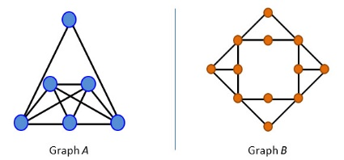
Graphs: Definitions Trails, Paths, and Circuits Matrix Representations Graph Isomorphism/Planar Graphs
Hamiltonian Circuits
AY2019/20 Sem1 Exam Question
Which of the following statements is true?
A. Graphs A and B are both Eulerian and Hamiltonian.
B. Graph A is both Eulerian and Hamiltonian; graph B is neither Eulerian nor Hamiltonian.
C. Graph A is Eulerian but not Hamiltonian; graph B is neither Eulerian nor Hamiltonian.
D. Graph A is Eulerian but not Hamiltonian; graph B is Hamiltonian but not Eulerian.
E. Graphs A and B are Hamiltonian but not Eulerian.


Slide 51
Graphs: Definitions Trails, Paths, and Circuits Matrix Representations Graph Isomorphism/Planar Graphs
Hamiltonian Circuits
Despite the analogous-sounding definitions of Euler and Hamiltonian circuits, the mathematics of the two are very different.
Determining whether a graph has an Euler circuit is easy – Theorem 10.2.4 gives a simple criterion.
Theorem 10.2.4
A graph G has an Euler circuit if and only if G is connected and every vertex of G has positive even degree.
Unfortunately, there is no analogous criterion for determining whether a given graph has a Hamiltonian circuit, nor is there even an efficient algorithm for finding such a circuit.

Slide 52
Graphs: Definitions Trails, Paths, and Circuits Matrix Representations Graph Isomorphism/Planar Graphs
Hamiltonian Circuits
There is, however, a simple technique that can be used in many cases to show that a graph does not have a Hamiltonian circuit.
Proposition 10.2.6
If a graph G has a Hamiltonian circuit, then G has a subgraph H with the following properties:
H contains every vertex of G.
H is connected.
H has the same number of edges as vertices.
Every vertex of H has degree 2.
The contrapositive of Proposition 10.2.6 says that if a graph G does not have a subgraph H with properties (1)–(4), then G does not have a Hamiltonian circuit.

Slide 53

Graphs: Definitions Trails, Paths, and Circuits Matrix Representations Graph Isomorphism/Planar Graphs
Travelling Salesman Problem
For reading only.
Travelling Salesman Problem
Imagine that the drawing below is a map showing four cities and the distances in kilometers between them.
Suppose that a salesman must travel to each city exactly once, starting and ending in city A. Which route from city to city will minimize the total distance that must be travelled?

Slide 54
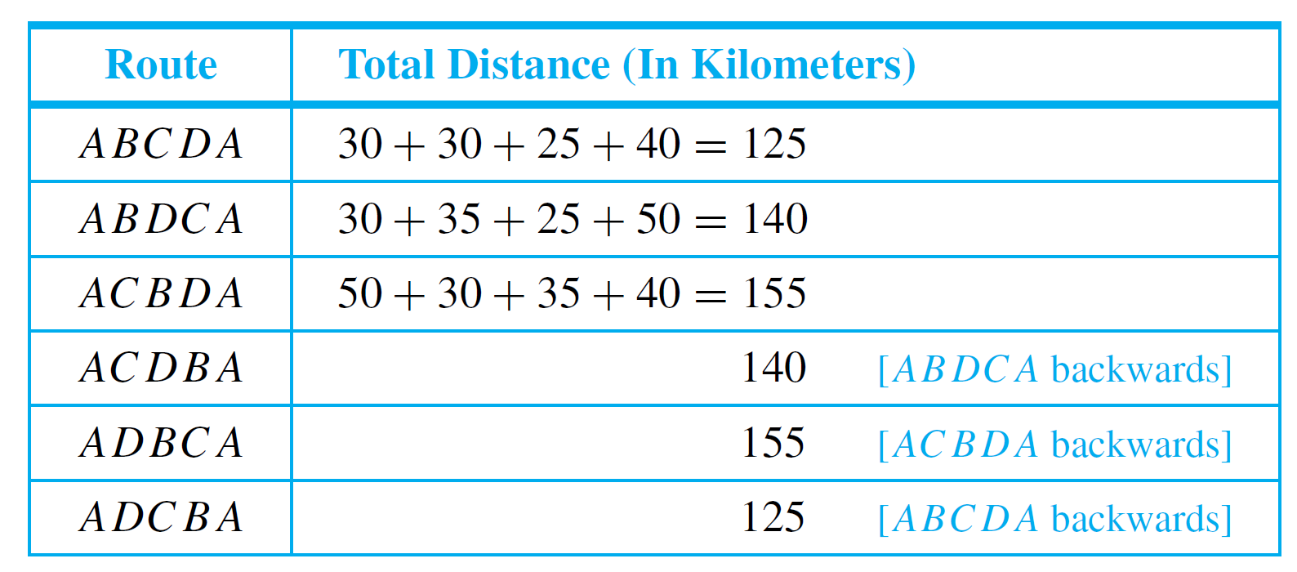
Graphs: Definitions Trails, Paths, and Circuits Matrix Representations Graph Isomorphism/Planar Graphs
Travelling Salesman Problem
This problem can be solved by writing all possible Hamiltonian circuits starting and ending at A and calculating the total distance travelled for each.
Thus either route ABCDA or ADCBA gives a minimum total distance of 125 km.

Slide 55
Graphs: Definitions Trails, Paths, and Circuits Matrix Representations Graph Isomorphism/Planar Graphs
Travelling Salesman Problem
The general travelling salesman problem involves finding a Hamiltonian circuit to minimize the total distance travelled for an arbitrary graph with n vertices in which each edge is marked with a distance.
One way to solve the general problem is to use the previous method: Write down all Hamiltonian circuits starting and ending at a particular vertex, compute the total distance for each, and pick one for which this total is minimal.
However, this is impractical for even medium-sized values of n. For n = 30 vertices, there would be (29!)/2 ≈ 4.42×10³⁰ Hamiltonian circuits starting and ending at a particular vertex to check. If each circuit could be found and its total distance computed in just one nanosecond, it would take approximately 1.4 ×10¹⁴ years to compute!

Slide 56
Graphs: Definitions Trails, Paths, and Circuits Matrix Representations Graph Isomorphism/Planar Graphs
Travelling Salesman Problem
At present, there is no known algorithm for solving the general travelling salesman problem that is more efficient.
However, there are efficient algorithms that find “pretty good” solutions — that is, circuits that, while not necessarily having the least possible total distances, have smaller total distances than most other Hamiltonian circuits.

Slide 57
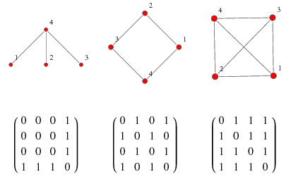
Graphs: Definitions Trails, Paths, and Circuits Matrix Representations Graph Isomorphism/Planar Graphs
10.3 Matrix Representations of Graphs

Slide 58
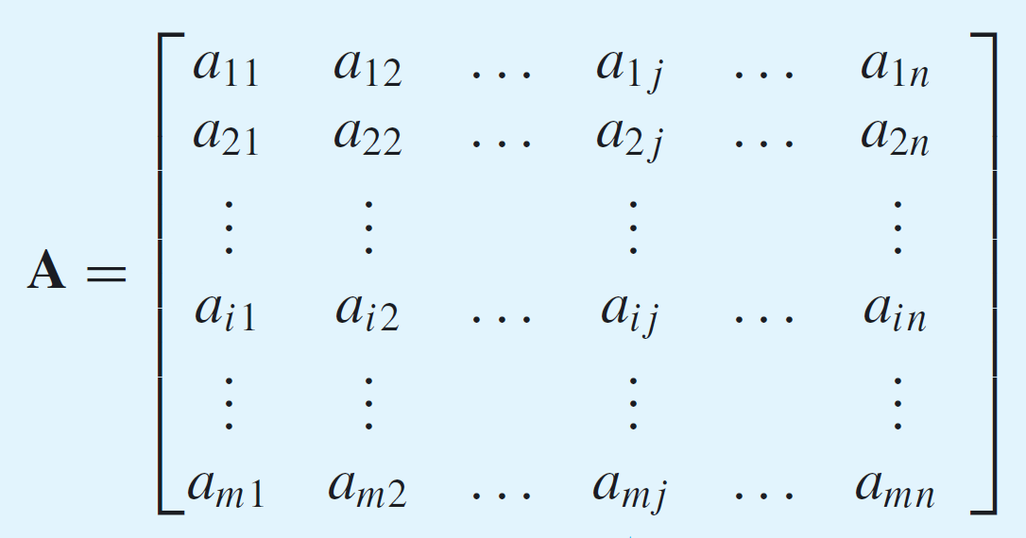

Graphs: Definitions Trails, Paths, and Circuits Matrix Representations Graph Isomorphism/Planar Graphs
Matrix Representations of Graphs
Matrices
Definition: Matrix
An m × n (read “m by n”) matrix A over a set S is a rectangular array of elements of S arranged into m rows and n columns.
We write A = ($a_{ij}$).
ith row of A
jth column of A

Slide 59
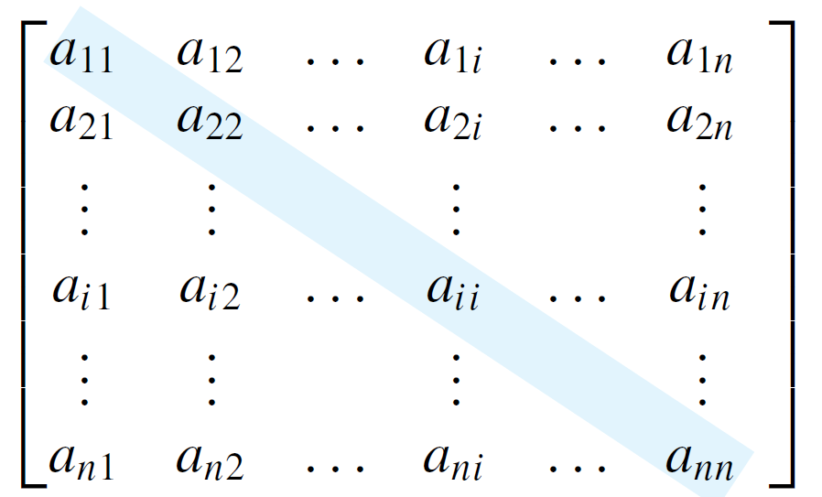
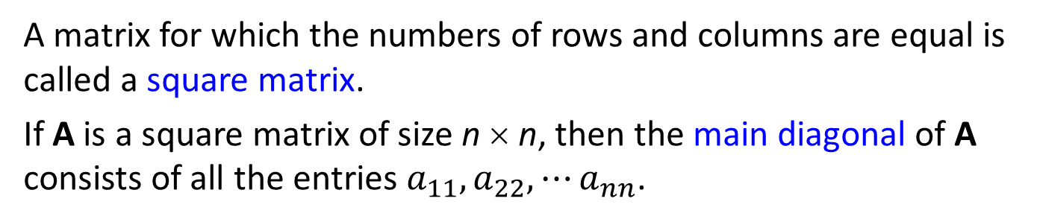
Graphs: Definitions Trails, Paths, and Circuits Matrix Representations Graph Isomorphism/Planar Graphs
Matrices
If A and B are matrices, then A = B if, and only if, A and B have the same size and the corresponding entries of A and B are all equal; that is,
$a_{ij}=b_{ij}$ for all $i=1, 2, ⋯, m$ and $j=1, 2, ⋯, n$.
A matrix for which the numbers of rows and columns are equal is called a square matrix.
If A is a square matrix of size n × n, then the main diagonal of A consists of all the entries $a_{11},a_{22},⋯a_{nn}$.
main diagonal of A

Slide 60

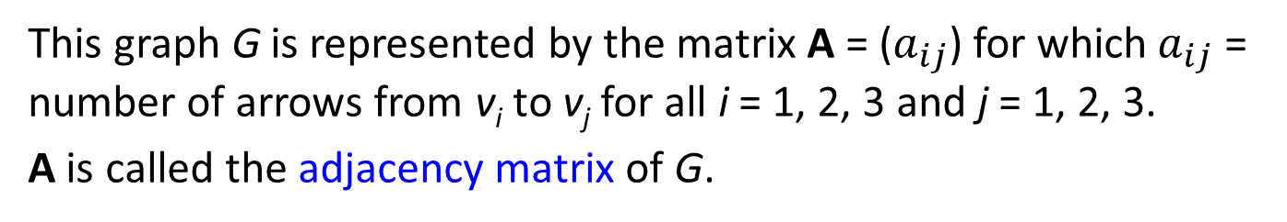
Graphs: Definitions Trails, Paths, and Circuits Matrix Representations Graph Isomorphism/Planar Graphs
Matrices and Directed Graphs
Matrices and Directed Graphs
Figure 10.3.1 A Directed Graph and Its Adjacency Matrix
This graph G is represented by the matrix A = ($a_{ij}$) for which${ a}_{ij}$ = number of arrows from v_{i} to v_{j} for all i = 1, 2, 3 and j = 1, 2, 3.
A is called the adjacency matrix of G.
Another common representation of a graph is the adjacency list, which is covered in algorithms module.

Slide 61


Graphs: Definitions Trails, Paths, and Circuits Matrix Representations Graph Isomorphism/Planar Graphs
Matrices and Directed Graphs
Definition: Adjacency Matrix of a Directed Graph
Let G be a directed graph with ordered vertices v₁, v₂, … v_{n}. The adjacency matrix of G is the n × n matrix A = ($a_{ij}$) over the set of non-negative integers such that
$a_{ij}$ = the number of arrows from v_{i} to v_{j} for all i, j = 1, 2, …, n.
Example: Find the adjacency matrices of the two directed graphs below.
(a)
(b)


Slide 62




Graphs: Definitions Trails, Paths, and Circuits Matrix Representations Graph Isomorphism/Planar Graphs
Matrices and Undirected Graphs
Matrices and Undirected Graphs
Definition: Adjacency Matrix of an Undirected Graph
Let G be an undirected graph with ordered vertices v₁, v₂, … v_{n}. The adjacency matrix of G is the n × n matrix A = ($a_{ij}$) over the set of non-negative integers such that
$a_{ij}$ = the number of edges connecting v_{i} and v_{j} for all i, j = 1, 2, …, n.
Example: Find the adjacency matrix for the graph G shown below.
Note that the matrix is symmetric.
Definition: Symmetric Matrix
An n × n square matrix A = ($a_{ij}$) is called symmetric if, and only if, $a_{ij}=a_{ji}$ for all i, j = 1, 2, …, n.

Slide 63

Graphs: Definitions Trails, Paths, and Circuits Matrix Representations Graph Isomorphism/Planar Graphs
Matrix Multiplication
Matrix Multiplication
Definition: Scalar Product
Suppose that all entries in matrices A and B are real numbers. If the number of elements, n, in the ith row of A equals the number of elements in the jth column of B, then the scalar product or dot product of the ith row of A and the jth column of B is the real number obtained as follows:
$$\left[\begin{matrix}\begin{matrix}a_{i1} & a_{i2}\end{matrix} & \begin{matrix}⋯ & a_{in}\end{matrix}\end{matrix}\right]\left[\begin{matrix}\begin{matrix}b_{1j} \\ b_{2j}\end{matrix} \\ \begin{matrix}⋮ \\ b_{nj}\end{matrix}\end{matrix}\right]= a_{i1}b_{1j}+a_{i2}b_{2j}+⋯+a_{in}b_{nj}.$$

Slide 64


Graphs: Definitions Trails, Paths, and Circuits Matrix Representations Graph Isomorphism/Planar Graphs
Matrix Multiplication
Definition: Matrix Multiplication
Let A = (a_{ij}) be an m × k matrix and B = (b_{ij}) an k × n matrix with real entries. The (matrix) product of A times B, denoted AB, is that matrix (c_{ij}) defined as follows:
where
$c_{ij}=a_{i1}b_{1j}+a_{i2}b_{2j}+⋯+a_{ik}b_{kj}=\sum_{r=1}^{k}{a_{ir}b_{rj}.}$
for all i = 1, 2, …, m and j = 1, 2, …, n.

Slide 65




Graphs: Definitions Trails, Paths, and Circuits Matrix Representations Graph Isomorphism/Planar Graphs
Matrix Multiplication
Example – Computing a Matrix Product
Solution:
2
3
where

Slide 66


Graphs: Definitions Trails, Paths, and Circuits Matrix Representations Graph Isomorphism/Planar Graphs
Matrix Multiplication
Example – Computing a Matrix Product
Solution:
2
3
-2
-1
where
–2

Slide 67

Graphs: Definitions Trails, Paths, and Circuits Matrix Representations Graph Isomorphism/Planar Graphs
Matrix Multiplication
Multiplication of real numbers is commutative, but matrix multiplication is not.
On the other hand, both real number and matrix multiplications are associative ((ab)c = a(bc), for all elements a, b, and c for which the products are defined).

Slide 68




Graphs: Definitions Trails, Paths, and Circuits Matrix Representations Graph Isomorphism/Planar Graphs
Matrix Multiplication
Identity Matrix
These computations show that acts as an identity on
the left side for multiplication with 2 × 3 matrices and that
acts as an identity on the right side for multiplication
with 3 × 3 matrices.

Slide 69

Graphs: Definitions Trails, Paths, and Circuits Matrix Representations Graph Isomorphism/Planar Graphs
Matrix Multiplication
Definition: Identity Matrix
For each positive integer n, the n × n identity matrix, denoted I_{n} = (δ_{ij}) or just I (if the size of the matrix is obvious from context), is the n × n matrix in which all the entries in the main diagonal are 1’s and all other entries are 0’s. In other words,
$δ_{ij}=\left\{\begin{aligned}1, if i=j \\ &0, if i≠j\end{aligned}\right.$ for all $i, j=1, 2, …, n.$
The German mathematician Leopold Kronecker introduced the symbol δ_{i j} to make matrix computations more convenient. In his honour, this symbol is called the Kronecker delta.

Slide 70





Graphs: Definitions Trails, Paths, and Circuits Matrix Representations Graph Isomorphism/Planar Graphs
Matrix Multiplication
n^{th} Power of a Matrix
Definition: n^{th} Power of a Matrix
For any n × n matrix A, the powers of A are defined as follows:
A⁰ = I where I is the n × n identity matrix
A^{n} = A A^{n – 1} for all integers n ≥ 1
Solution:

Slide 71
Graphs: Definitions Trails, Paths, and Circuits Matrix Representations Graph Isomorphism/Planar Graphs
Counting Walks of Length N
Counting Walks of Length N
A walk in a graph consists of an alternating sequence of vertices and edges.
If repeated edges are counted each time they occur, then the number of edges in the sequence is called the length of the walk.
For instance, the walk v₂e₃v₃e₄v₂e₂v₂e₃v₃ has length 4 (counting e₃ twice).

Slide 72

Graphs: Definitions Trails, Paths, and Circuits Matrix Representations Graph Isomorphism/Planar Graphs
Counting Walks of Length N
Example: Consider the following graph G.
How many distinct walks of length 2 connect v₂ and v₂?
One walk of length 2 from v₂ to v₂ via v₁: v₂e₁v₁e₁v₂.
One walk of length 2 from v₂ to v₂ via v₂: v₂e₂v₂e₂v₂.
Four walks of length 2 from v₂ to v₂ via v₃: v₂e₃v₃e₄v₂ ,
v₂e₄v₃e₃v₂,
v₂e₃v₃e₃v₂,
v₂e₄v₃e₄v₂.
Total = 6

Slide 73



Graphs: Definitions Trails, Paths, and Circuits Matrix Representations Graph Isomorphism/Planar Graphs
Counting Walks of Length N
The general question of finding the number of walks that have a given length and connect two particular vertices of a graph can easily be answered using matrix multiplication.
Consider the adjacency matrix A of the graph G.
Compute A²:
Note that the entry in row 2 and column 2 is 6, which equals the number of walks of length 2 from v₂ to v₂.
Reason: To compute a₂₂, you multiply row 2 of A with column 2 of A to obtain a sum of three terms:

Slide 74
Graphs: Definitions Trails, Paths, and Circuits Matrix Representations Graph Isomorphism/Planar Graphs
Counting Walks of Length N
More generally, if A is the adjacency matrix of a graph G, the i j-th entry of A² equals the number of walks of length 2 connecting the i-th vertex to the j-th vertex of G.
Even more generally, if n is any positive integer, the i j-th entry of A^{n} equals the number of walks of length n connecting the i-th and the j-th vertices of G.
Theorem 10.3.2
If G is a graph with vertices v₁, v₂, …, v_{m} and A is the adjacency matrix of G, then for each positive integer n and for all integers i, j = 1, 2, …, m,
the ij-th entry of A^{n} = the number of walks of length n from v_{i} to v_{j}.

Slide 75

Graphs: Definitions Trails, Paths, and Circuits Matrix Representations Graph Isomorphism/Planar Graphs
10.4 Planar Graphs

Slide 76

Graphs: Definitions Trails, Paths, and Circuits Matrix Representations Graph Isomorphism/Planar Graphs
Planar Graphs
Isomorphisms of Graphs
The two drawings shown in Figure 10.4.1 both represent the same graph: Their vertex and edge sets are identical, and their edge-endpoint functions are the same. Call this graph G.
Figure 10.4.1

Slide 77



Graphs: Definitions Trails, Paths, and Circuits Matrix Representations Graph Isomorphism/Planar Graphs
Isomorphisms of Graphs
Now consider the graph G' represented in Figure 10.4.2.
$$G$$
$$G′$$
Figure 10.4.1
Figure 10.4.2
Observe that G' is a “different graph” from G in terms of the labelling of the vertices and edges (for instance, in G the endpoints of e₁ are v₁ and v₂, whereas in G' the endpoints of e₁ are v₁ and v₃).

Slide 78


Graphs: Definitions Trails, Paths, and Circuits Matrix Representations Graph Isomorphism/Planar Graphs
Isomorphisms of Graphs
Yet G' is certainly very similar to G. In fact, if the vertices and edges of G' are relabeled by the functions shown in Figure 10.4.3, then G' becomes the same as G.
G
G'
Figure 10.4.3
Note that these relabeling functions are bijective.

Slide 79



Graphs: Definitions Trails, Paths, and Circuits Matrix Representations Graph Isomorphism/Planar Graphs
Isomorphisms of Graphs
Two graphs $G$ and $G′$ that are the same except for the labeling of their vertices and edges are called isomorphic. In other words, there exists matching between the vertices such that two vertices are connected by an edge in $G$ if and only if corresponding vertices are connected by an edge in $G′$.
Definition: Isomorphic Graph
Let $G=(V_{G},E_{G})$ and $G^{′}=(V_{G^{′}},E_{G′})$be two graphs.
$G$ is isomorphic to $G′$, denoted $G≅G′$, if and only if there exist bijections $g:V_{G}{→V}_{G^{′}}$ and $h:E_{G}{→E}_{G^{′}}$that preserve the edge-endpoint functions of $G$ and $G′$ in the sense that for all $v∈V_{G}$and $e∈E_{G}$,
$v$ is an endpoint of $e$ ⇔ $g(v)$ is an endpoint of $h(e)$.
Alternative definition
Let $G=(V_{G},E_{G})$ and $G^{′}=(V_{G^{′}},E_{G′})$be two graphs.
$G$ is isomorphic to $G′$ if and only if there exists a permutation $π:V_{G}{→V}_{G^{′}}$ such that $\{u,v\}∈E_{G}$ ⇔$\{π(u),π(v)\}∈E_{G′}$.

Slide 80




Graphs: Definitions Trails, Paths, and Circuits Matrix Representations Graph Isomorphism/Planar Graphs
Isomorphisms of Graphs
Example: Show that the following two graphs are isomorphic.


Slide 81


Graphs: Definitions Trails, Paths, and Circuits Matrix Representations Graph Isomorphism/Planar Graphs
Isomorphisms of Graphs
It is not hard to show that graph isomorphism is an equivalence relation on a set of graphs; in other words, it is reflexive, symmetric, and transitive.
Theorem 10.4.1 Graph Isomorphism is an Equivalence Relation
Let S be a set of graphs and let $≅$ be the relation of graph isomorphism on S. Then $≅$ is an equivalence relation on S.
Exercise: Prove that graph isomorphism $≅$ is an equivalence relation.

Slide 82
Graphs: Definitions Trails, Paths, and Circuits Matrix Representations Graph Isomorphism/Planar Graphs
Planar Graphs
Definition: Planar Graph
A planar graph is a graph that can be drawn on a (two-dimensional) plane without edges crossing.
Is Figure 10.4.4 a planar graph?
a
b
c
d
e
Figure 10.4.4


Slide 83




Graphs: Definitions Trails, Paths, and Circuits Matrix Representations Graph Isomorphism/Planar Graphs
Planar Graphs
Examples of non-planar graphs
$$K_{5}$$
$$K_{3,3}$$
Kuratowski’s Theorem:
A finite graph is planar if and only if it does not contain a subgraph that is a subdivision of the complete graph $K_{5}$ or the complete bipartite graph $K_{3,3}$.

Slide 84






Graphs: Definitions Trails, Paths, and Circuits Matrix Representations Graph Isomorphism/Planar Graphs
Planar Graphs
Euler’s Formula
When we draw a planar representation of a planar graph, it divides the plane up into regions or faces.
$$a_{0}$$
F1
$$a_{3}$$
$$a_{1}$$
F2
F4
$$a_{2}$$
(F4 = ‘outside’ the planar graph)
F3
$$a_{5}$$
$$a_{4}$$

Slide 85






Graphs: Definitions Trails, Paths, and Circuits Matrix Representations Graph Isomorphism/Planar Graphs
Euler’s Formula
Euler’s Formula
For a connected planar simple graph G = (V, E) with e = |E| and v = |V|, if we let f be the number of faces, then
f = e – v + 2
$$a_{0}$$
e = 8
v = 6
f = 8 – 6 + 2 = 4
F1
$$a_{3}$$
$$a_{1}$$
F2
F4
$$a_{2}$$
F3
$$a_{5}$$
$$a_{4}$$

Slide 86

Next week’s lectures
Trees

Slide 87
END OF FILE

